Slide 1
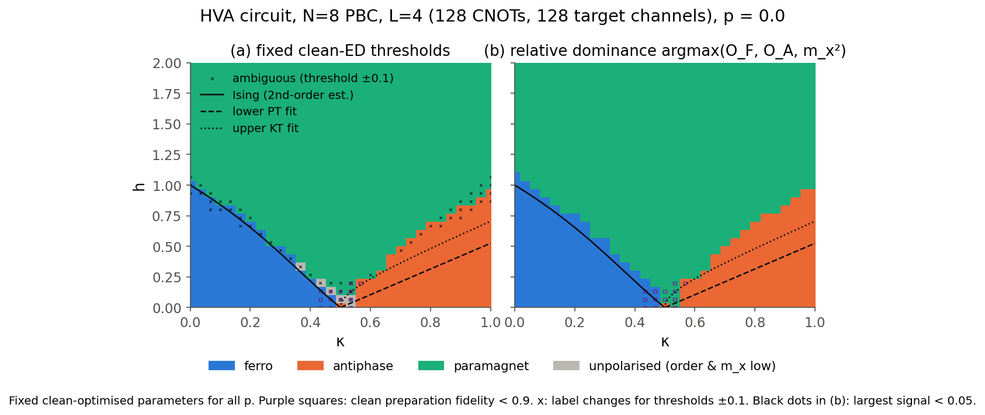
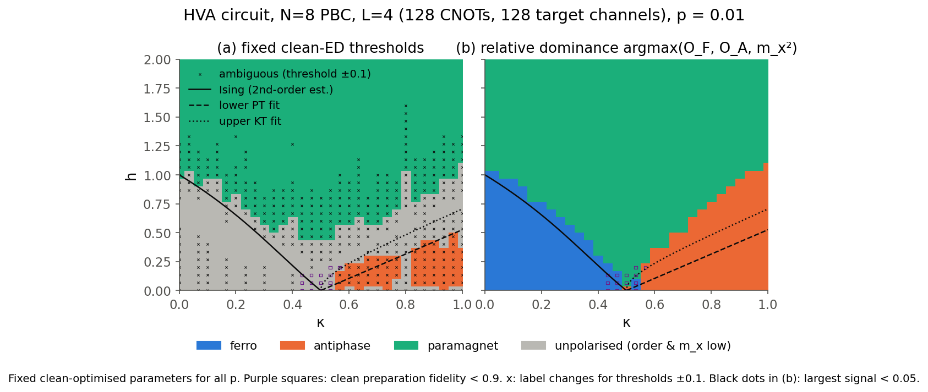
The ANNNI phase diagram under CNOT-target depolarizing noise
Exact diagonalisation, a 128-CNOT variational circuit, and what 1% and 5% noise do to the phases
Benjamin Kaganovitch · Dimitrii Kashtanov · Yan Ivanov · Frederick Pu
Q-SITE Hacks 2026 · Quantum Coalition Scientific Open Challenge
github.com/BenjaminKaganovitch/qsite-2026-open-challenge
Notes:
We mapped the ANNNI phase diagram on small periodic rings, then asked what the challenge's noise model, a depolarizing channel on the target after every CNOT, does to it. Headline: at p equals 0.01 the ferromagnet disappears under fixed thresholds, even though the boundary positions defined by derivatives barely move. At p equals 0.05 the state is essentially maximally mixed. Zero-noise extrapolation restores the p equals 0.01 diagram. (30 s)

Slide 2
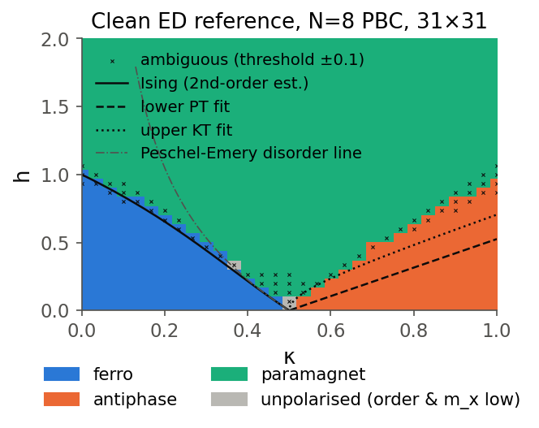
Model, order parameters and reference curves
H = −Σ Z_{i}Z_{i+1} + κ Σ Z_{i}Z_{i+2} − h Σ X_{i}
Ferromagnet
Antiphase
Paramagnet
κ small, h small. All Z aligned; S(0) = N.
κ > ½, h small. Period-4 pattern ↑↑↓↓; S(π/2) = N/2.
h large. Spins follow the field; m_x → 1.
Finite rings keep the spin-flip symmetry, so ⟨Z⟩ = 0 even in ordered phases: we classify with correlations.
Structure factor S(q) = (1/N) Σ e^{iq(i−j)} ⟨Z_i Z_j⟩; floor-subtracted O_F = (S(0)−1)/(N−1), O_A = (S(π/2)−1)/(N/2−1), plus m_x.
Overlay curves are approximate thermodynamic references: Ising estimate, Pokrovsky–Talapov line 1.05(κ−½), KT line 1.05√((κ−½)(κ−0.1)).
Thresholds T = 0.541, T_x = 0.490 are calibrated on limiting-case anchor regions, not on the curves.
Exact ground states, N = 8 periodic, 31 × 31 grid. Ferro (blue), antiphase (orange), paramagnet (green).
github.com/BenjaminKaganovitch/qsite-2026-open-challenge
2
Notes:
Three competing terms: ferromagnetic nearest-neighbour coupling, frustrating next-nearest-neighbour coupling, and a transverse field. Finite rings keep the global spin-flip symmetry, so the one-point magnetisation vanishes even in ordered phases. We therefore use the structure factor at q = 0 and q = pi over 2, with the uncorrelated floor subtracted, together with m_x. The overlay curves are approximate thermodynamic fits: the lower one is a Pokrovsky-Talapov transition and the upper one KT. They are references, not labels, and our thresholds come from limiting-case anchor regions rather than from these curves. (45 s)

Slide 3
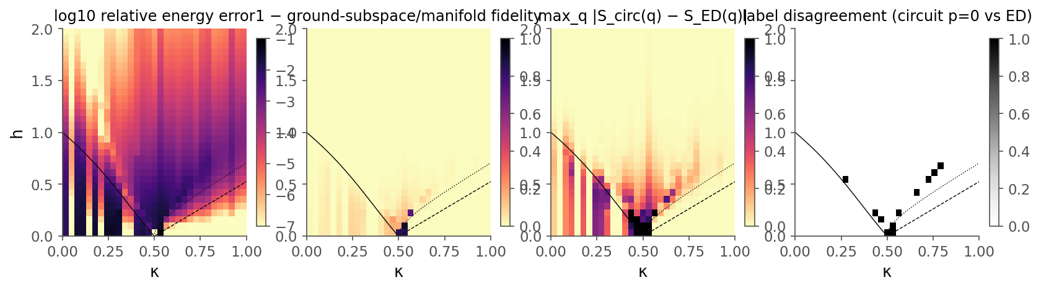
Methods and validation
1
Exact reference
98.9%
4e-5
1e-14
Sparse Lanczos (six lowest eigenpairs), N = 8, 10, 12 on 31 × 31 grids plus 21 × 401 fine cuts. Warm and cold starts agree to 1e-13.
circuit labels agree with exact diagonalisation
median relative energy error at p = 0
engines match PennyLane default.qubit / mixed
2
Variational circuit
Hamiltonian-variational ansatz: |+⟩^N then L = 4 layers of (ZZ_nn, ZZ_nnn, X) rotations, 12 parameters, symmetry preserving. Each ZZ bond is CNOT–RZ–CNOT: 128 CNOTs.
3
Noise model
Clean circuit vs exact ground states: relative energy error, 1 − fidelity, ambiguity and label agreement.
DepolarizingChannel(p) on the target after every CNOT on default.mixed; 128 channels verified on the tape. Same parameters, grid and thresholds at p = 0, 0.01, 0.05.
A hardware-efficient RY/CNOT ring stalled at 1–3% energy error near the boundaries even at depth 6; the HVA does not.
Parameters optimised at p = 0 by L-BFGS with exact adjoint gradients, warm-started sweeps and restarts.
github.com/BenjaminKaganovitch/qsite-2026-open-challenge
3
Notes:
The reference is sparse exact diagonalisation; the circuit is a Hamiltonian-variational ansatz. We first tried a hardware-efficient ansatz, which could not get below 1 to 3 percent energy error near the boundaries. The HVA reaches a median energy error of 4e-5 and agrees with the exact labels at 98.9 percent of points. The cost is 128 CNOTs, so 128 noise channels. Every layer of the pipeline is validated against PennyLane to about 1e-14. (45 s)

Slide 4
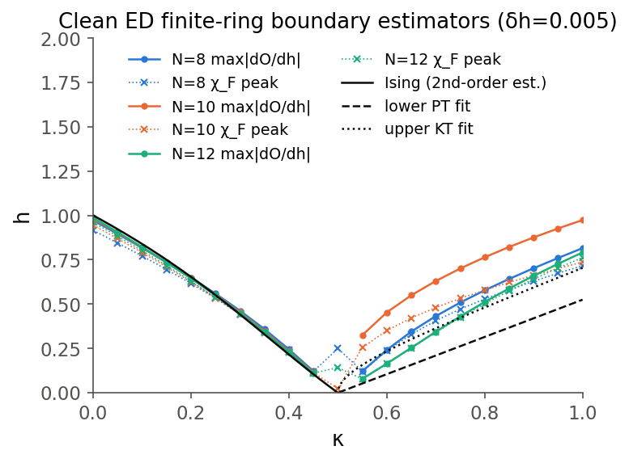
Exact phase diagram and finite-size behaviour
0.616 → 0.629
0.562 → 0.432
ferro boundary at κ = 0.2, N = 8 → 12 (DMRG 0.639)
antiphase boundary at κ = 0.75, N = 8 → 12 (KT fit 0.423)
Ferro–para boundary is almost size independent and tracks the Ising estimate; the fidelity-susceptibility peak moves toward the DMRG value.
Antiphase boundary drifts down strongly with N toward the KT line, the expected slow finite-size behaviour of a KT-like transition.
N = 10 cannot hold a period-4 pattern and is anomalous (a commensurability effect, not thermodynamic physics).
Floating phase: at N = 12 the entanglement entropy peaks near the KT line, but the ordering wavevector stays locked at π/2. We call it unresolved rather than claim it.
A label-free k-means on (S(q)/N, m_x) reproduces the rule labels at 99.1%.
Boundary estimators from exact diagonalisation at N = 8, 10, 12 with the Ising, PT and KT reference curves.
github.com/BenjaminKaganovitch/qsite-2026-open-challenge
4
Notes:
The ferro boundary hardly depends on N and sits on the Ising estimate; the fidelity-susceptibility peak moves towards the DMRG value. The antiphase boundary drifts down strongly with N towards the KT line, which is the expected slow, KT-like finite-size behaviour. N = 10 cannot hold a period-4 pattern and is anomalous. On the floating phase we are careful: at N = 12 the entanglement entropy peaks near the KT line, but the ordering wavevector stays locked at pi over 2, so we call it unresolved. (60 s)

Slide 5
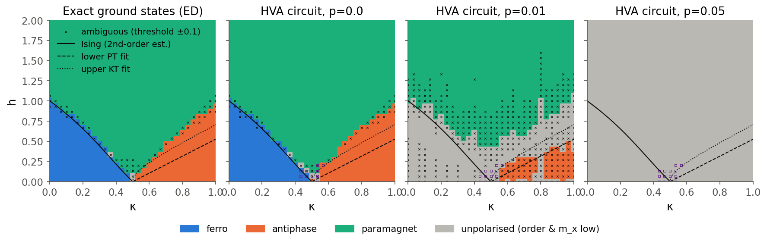
Effect of depolarising noise at p = 0.01 and 0.05
Same circuit, parameters, grid and thresholds. Left to right: exact reference, circuit at p = 0, 0.01, 0.05. Purple: clean fidelity < 0.9; ×: threshold-ambiguous.
0.60
0%
0.005
0.0047
median contraction of order parameters at p = 0.01
of ferro points keep their label at p = 0.01 under fixed thresholds; recalibrated thresholds recover all 142
median shift of derivative-peak boundaries at p = 0.01
purity at p = 0.05 (maximally mixed: 0.0039); order parameters keep 8.5%, m_x 16%
github.com/BenjaminKaganovitch/qsite-2026-open-challenge
5
Notes:
At p = 0.01 the order drops to about 60 percent of its clean value, but not evenly: the ferromagnet falls to 0.37 while the antiphase keeps 0.59. With fixed thresholds the ferromagnet vanishes from the map, though recalibrating the thresholds recovers it, so it is the absolute signal that is lost, not the phase. The field where the order changes fastest barely moves, median shift 0.005. At p = 0.05 the purity is only 20 percent above that of a fully mixed state. The noise does not change the Hamiltonian; what degrades is the prepared state. (60 s)

Slide 6
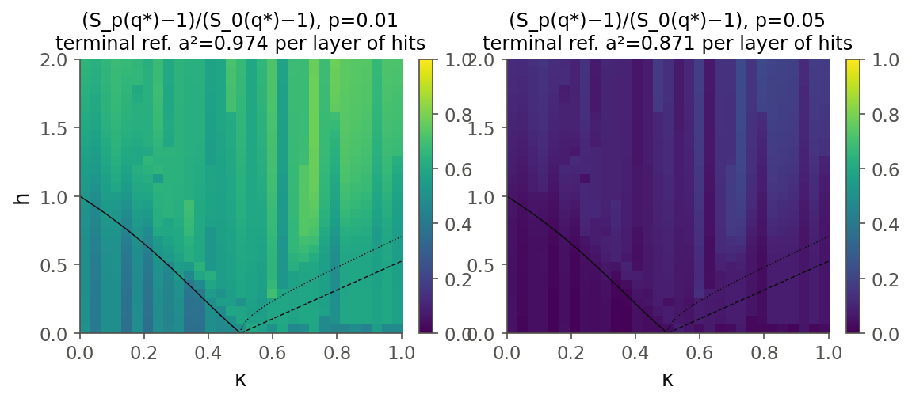
Channel-insertion analysis of noise sensitivity
First-order response of each order parameter, summed over all 128 channel locations: d ln O / dp
−99
−69
−32 to −48
−43 | −21
ferromagnet, O_F
antiphase, O_A
paramagnet, m_x
end-of-circuit baseline: pair correlators | m_x
Measured sensitivities exceed their end-of-circuit baselines by 2.3× (ferro), 1.6× (antiphase) and 1.5–2.3× (m_x): mid-circuit errors propagate through later CNOT–RZ–CNOT gadgets.
Early layers contribute most: for the ferro point, layer 1 gives −27 and layer 4 gives −17.
The states themselves are not the reason: one flipped qubit removes the same fraction (about 4/N) of the correlators in O_F and O_A. The gap is circuit dynamics plus the ferro state needing full depth.
First-order theory gets the sign of the boundary shift right but underestimates it 1.5–4×: p = 0.01 is already nonlinear at this depth.
This ranking is specific to this circuit and diagnostic; it reverses the organiser's hypothesis but is not a law about the phases.
Ratio of noisy to clean structure factor at the dominant wavevector: p = 0.01 (left) and p = 0.05 (right).
github.com/BenjaminKaganovitch/qsite-2026-open-challenge
6
Notes:
We calculated the exact first-order effect of each of the 128 channels separately. The ferromagnet is 2.3 times more sensitive than end-of-circuit counting predicts, the antiphase 1.6 times: errors made early are carried through the later gates. The states themselves do not explain the gap, since one flipped qubit costs both phases the same fraction of correlators; it is circuit dynamics and depth. The first-order formula gets the direction of the shift right but underestimates its size, because p = 0.01 is already nonlinear for this circuit depth. This ranking belongs to this circuit and diagnostic; it is not a law about the phases. (45 s)

Slide 7
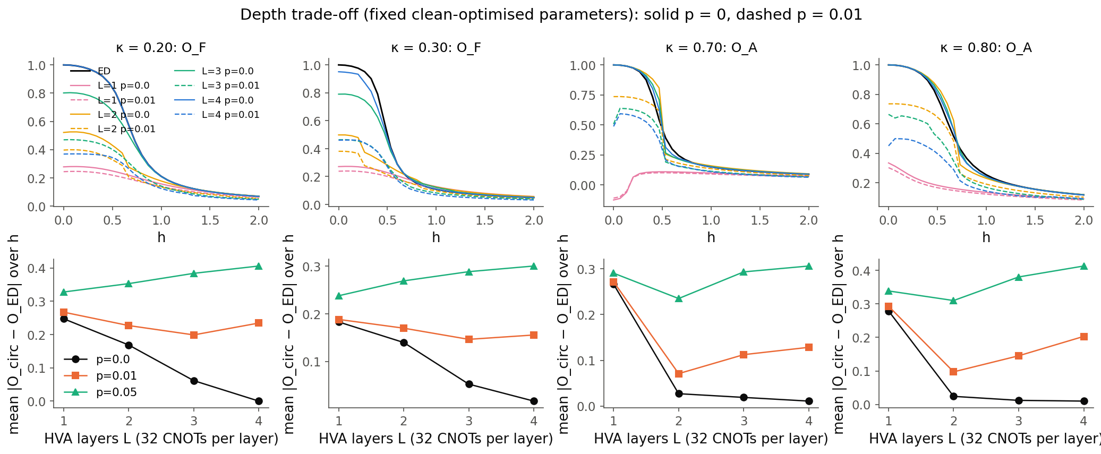
Circuit depth, re-optimisation and clustering
Noise-aware re-optimisation
Minimising Tr(Hρ_p) with exact gradients through the channels lowers the noisy energy by 0.2–1.0 per cut, but the order parameters move by only −0.016 to +0.028. The optimiser gains energy through m_x by leaving the ground state (clean energy −5.83 vs −6.40 at κ = 0.2, h = 0). Energy-optimal noisy states are not diagnostic-optimal.
Clean error and noisy error against depth L = 1–4 on four κ cuts. The best depth falls as p grows.
Label-free clustering
Shallow circuits are wrong even without noise; deep ones collect more noise. The antiphase is accurate at L = 2 (error 0.024 at κ = 0.8), the ferromagnet needs L = 4 (error 0.17 at L = 2).
At p = 0.01 the best depth is L = 3 for ferro and L = 2 for antiphase: a second reason the ferromagnet suffers most.
k-means on (S(q)/N, m_x) reproduces the clean rule labels at 99.1%: a consistency check, not independent validation.
github.com/BenjaminKaganovitch/qsite-2026-open-challenge
7
Notes:
We reran the same experiment with shallower circuits. Shallow circuits are wrong even without noise, and deep ones collect more noise, so the best depth falls as p rises. The antiphase is already accurate with two layers, while the ferromagnet needs all four. That is a second reason the ferromagnet suffers most. We also tried re-optimising the parameters at each noise level: the noisy energy improves, but only by pushing the state towards the field direction; the order parameters barely change, so the state that minimises the noisy energy is not the one that best reveals the phase. A label-free k-means clustering of the same observables reproduces our clean labels at 99 percent. (50 s)

Slide 8
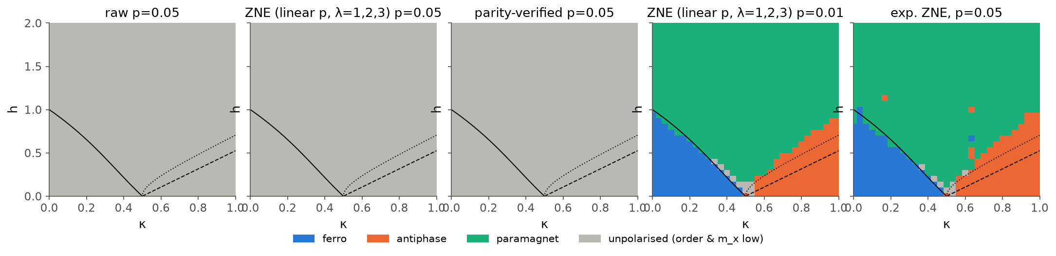
Error mitigation by extrapolation and parity checks
Fixed thresholds. Raw p = 0.05; Richardson ZNE at p = 0.05 (fails); parity-verified p = 0.05; Richardson ZNE at p = 0.01; two-point exponential ZNE at p = 0.05 (λ = 1, 2).
0.063 → 0.011
70% → 98%
97.5%
× 19 · 71%
median correlator error at p = 0.01 after ZNE
label agreement with the clean circuit after ZNE
labels recovered at p = 0.05 by exponential ZNE (Richardson: fails); variance cost ≈ 5 × 10⁴
Richardson variance factor at p = 0.01 · parity-check acceptance (error only 0.063 → 0.053)
github.com/BenjaminKaganovitch/qsite-2026-open-challenge
8
Notes:
Zero-noise extrapolation on the correlators, never on the labels, with the clean result held out: at p = 0.01 the correlator error falls six-fold and 98 percent of labels are recovered, at the price of about 19 times more variance. At p = 0.05 Richardson fails, because the correlators decay exponentially in p and a polynomial cannot follow that. A two-point exponential model does: 97.5 percent of labels come back, but at a variance cost of about fifty thousand, so on hardware this is not free. Parity verification helps only a little, because most errors keep the parity. (45 s)

Slide 9
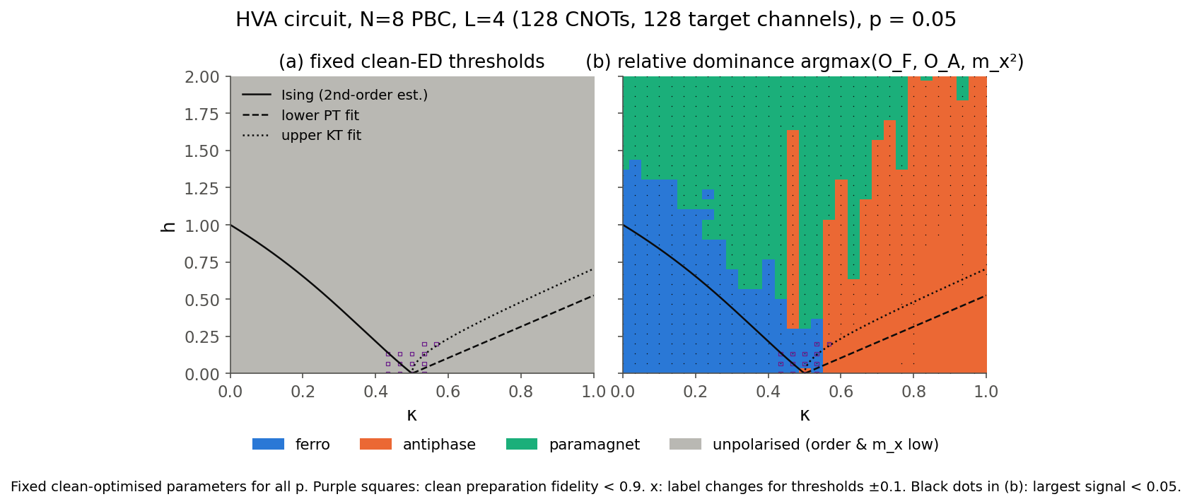
Conclusions and limitations
1
Accurate clean diagram: on 8–12-site rings; the ferro side converges quickly, the antiphase side drifts toward the KT line.
Limitations
Small N (≤ 12); overlays are approximate
κ ≈ 0.5 masked for preparation quality
Fixed-parameter protocol on the full grid; re-optimisation only on cuts
Exact simulation, no shot noise
2
1% noise removes absolute ferromagnetic order: under fixed thresholds, while derivative-defined boundaries stay put; recalibrated thresholds still find the phase. 5% leaves only a weak signal.
3
Depth vs noise is the real trade-off: the state that needs the full circuit carries the most channels and suffers first.
4
Mitigation depends on the model: Richardson ZNE restores p = 0.01; only an exponential model restores p = 0.05, at ~5 × 10⁴ variance cost. Parity checks help little.
github.com/BenjaminKaganovitch/qsite-2026-open-challenge
Quench dynamics: a Trotterised quench from |+⟩ shows a sharp Loschmidt-rate peak only deep in the ordered side (h ≤ 0.4); at p = 0.01 the channel error is about 8× the Trotter error, so the dynamical signature does not survive noise.
Notes:
An accurate clean diagram; the ferro side converges quickly while the antiphase side drifts towards KT. For a circuit deep enough to be right, 1 percent noise already removes absolute order, and 5 percent leaves only a weak signal: depth versus noise is the real trade-off. We also ran a quench from the fully polarised state: the Loschmidt rate peaks sharply only for quenches deep into the ordered side, but at p = 0.01 the channel error is about eight times the Trotter error, so the dynamical signature does not survive noise. Limitations: small N, approximate overlays, the fixed-parameter protocol, and no shot noise. (30 s)

